Slide 1
X-Car review n°2
Team Chidi
December 5 / 2023
Authors :
Ana Carolina Coelho Robl
Arthur Nicola
Baptiste Turpin
Loïc Thomas
Nicolas Siard
Pierre Bonnecaze
Louis Vialan
Well-John Lu

Slide 2
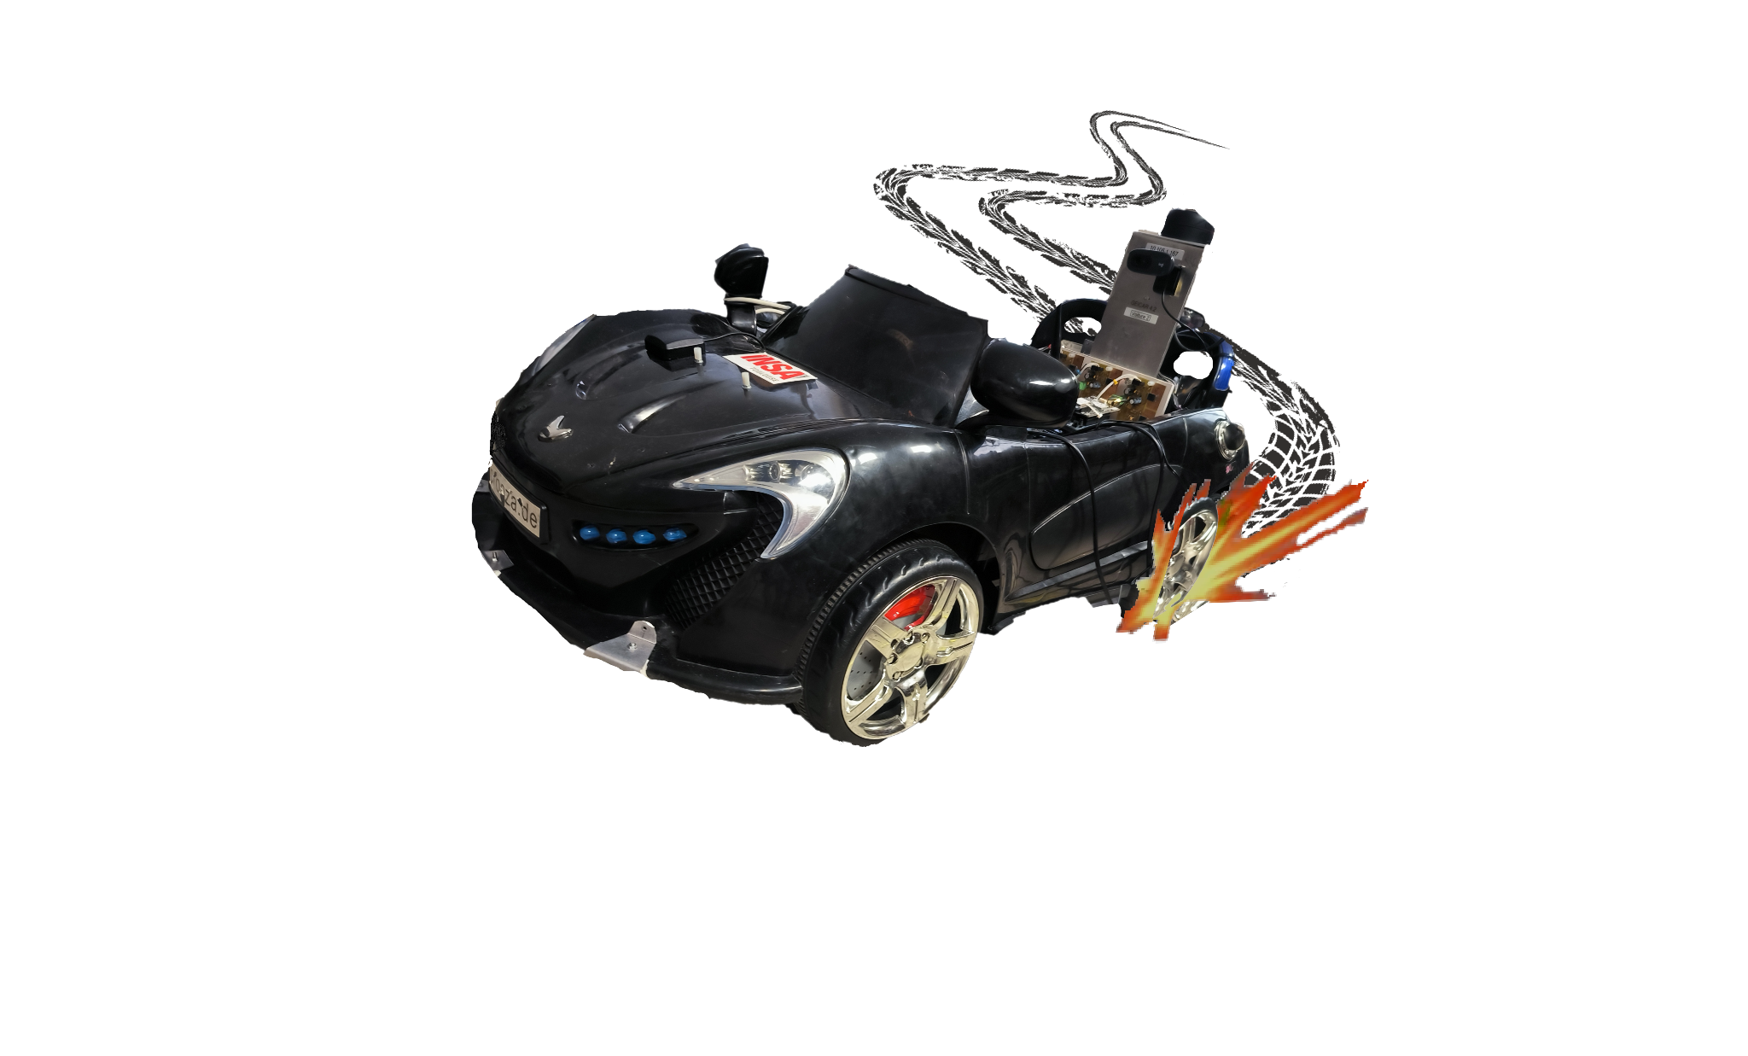



Introduction - why the X-Car ?
Transport heavy loads around the campus
An intelligent car that you can trust
An intuitive interface for the user

Slide 3
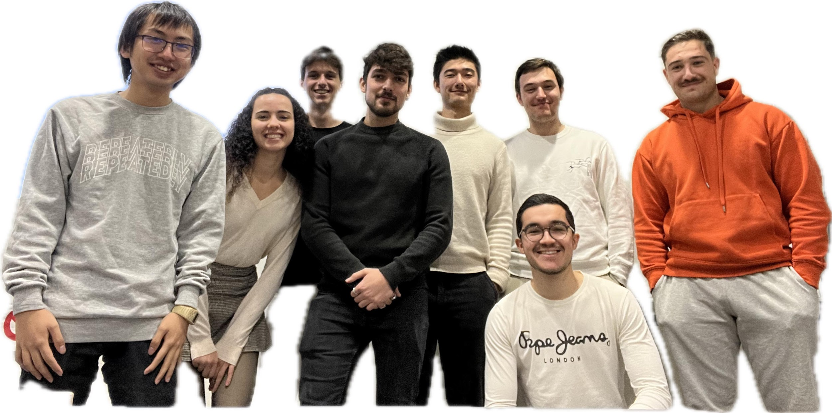

The team

Slide 4



Realised Stories
Story 1 : Web interface
Story 2 : Obstacle detection with Lidar
Story 3 : Tracking a person

Slide 5
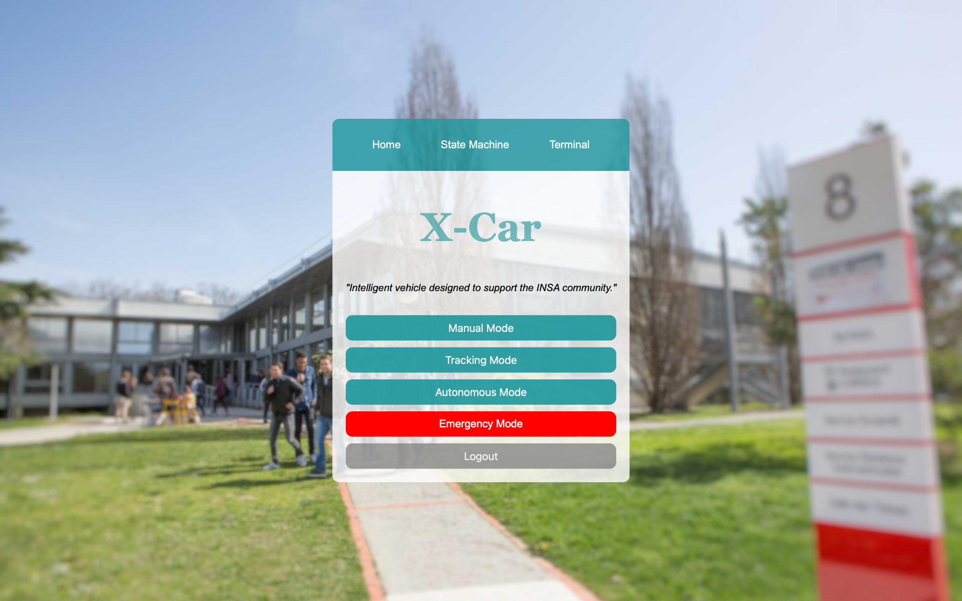
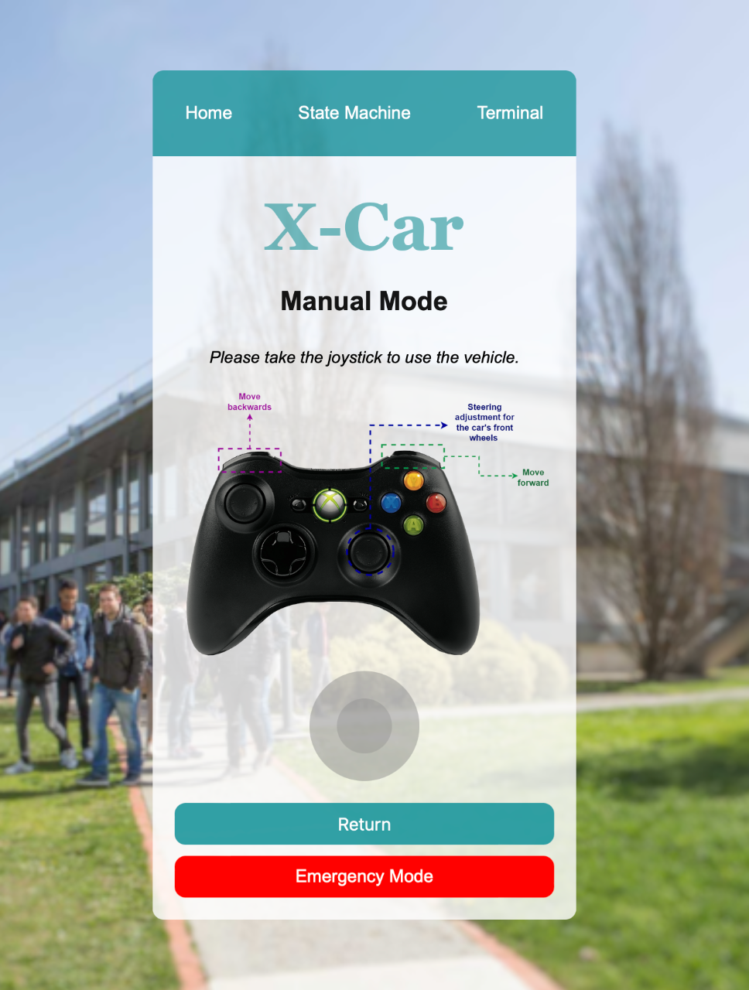
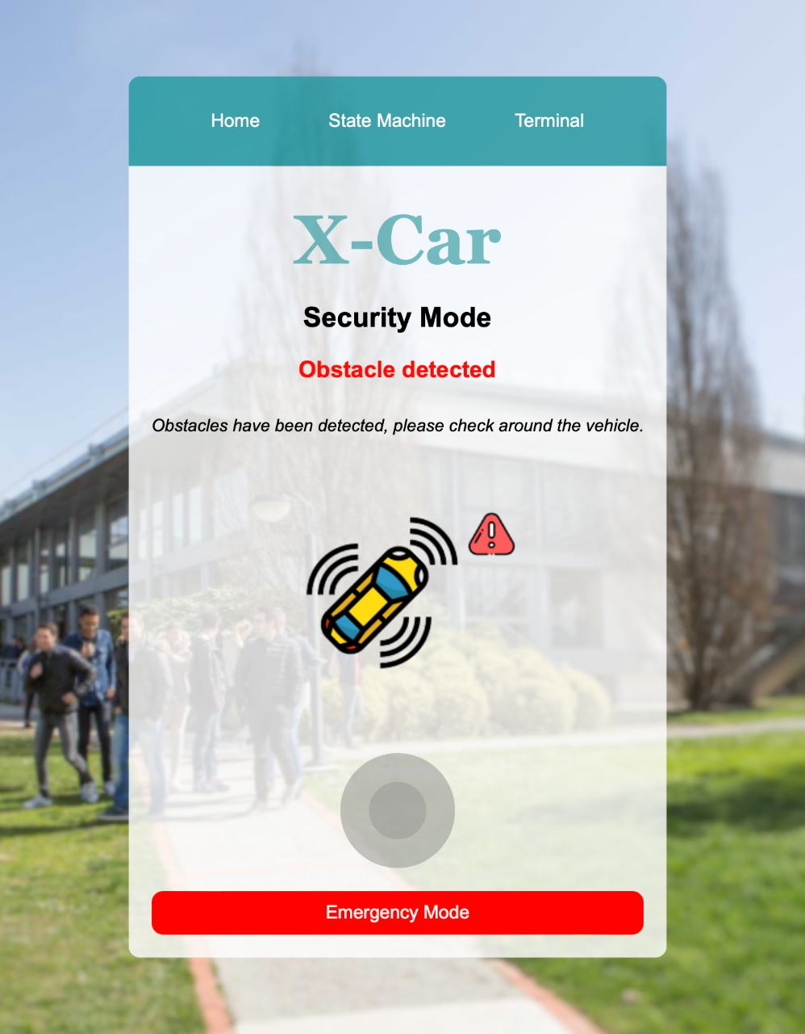
Story 1 : Web interface
Web interface: As a user, I want to navigate on a web application in order to change the modes of the vehicle or to stop it. I also want to have visual feedback on my interface
Implement our modes and the visual feedback in the interface

Slide 6




Story 1 : Web interface
Set up the communication between the application and the Xcar

Slide 7
Story 1 : Web interface
Test
Check that all the modes are implemented on the web interface
Check that all transitions of the state machine are respected and functional with the X-Car
Check that the user has access to visual feedback and history on the interface

Slide 8

Story 2: Obstacle detection with the Lidar
Obstacles must be detected at 70cm forward and backward
70 cm

Slide 9

Story 2: Obstacle detection with the Lidar

Slide 10

Story 2: Obstacle detection with the Lidar
X-Car stops at least 20cm from an obstacle
Xcar Stopped
20 cm

Slide 11
Story 3: Tracking a person
Following a person at a fixed distance in a straight line
1.50m

Slide 12

Story 3: Tracking a person
Following a person at a fixed distance in a straight line
Ultrasonic sensors
Proportional controller
Does not initialize the target
Does not incorporate obstacles detection yet !
1.50m

Slide 13
Story 3: Tracking a person
Test
Stand at about 2 meters in front of the car
Start the tracking mode by pressing the X button on the joystick
Check if the car drives forward to reach the 1.5 meters distance from the user
Walk toward the car and check if the car drives backward to stay at 1.5 meters from the user
1.50m

Slide 14
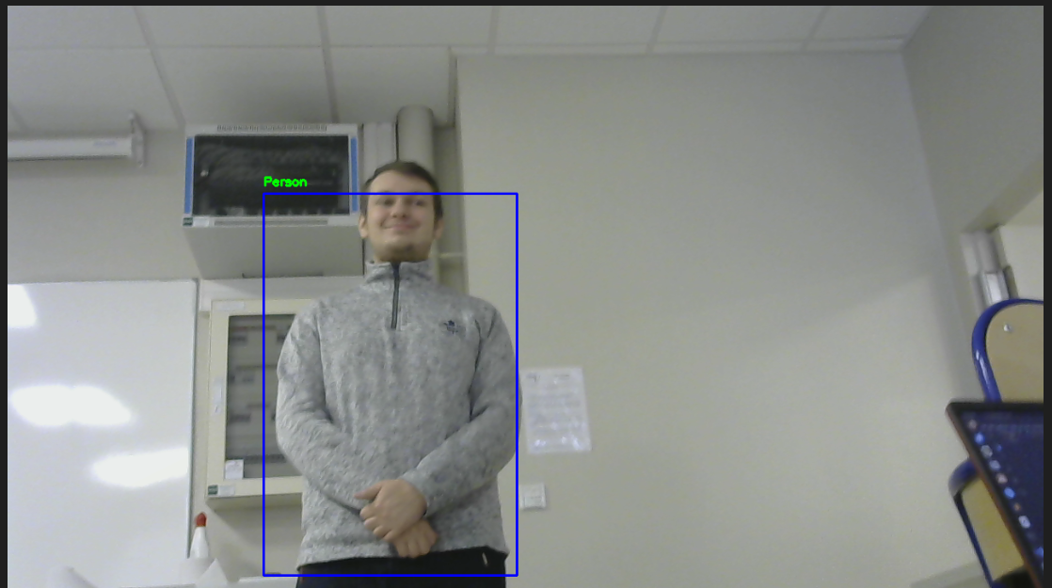
Story 3: Tracking a person
Human detection using the Camera

Slide 15

Story 3: Tracking a person
Return the distance between the XCar and the user, using the Lidar
user_distance

Slide 16
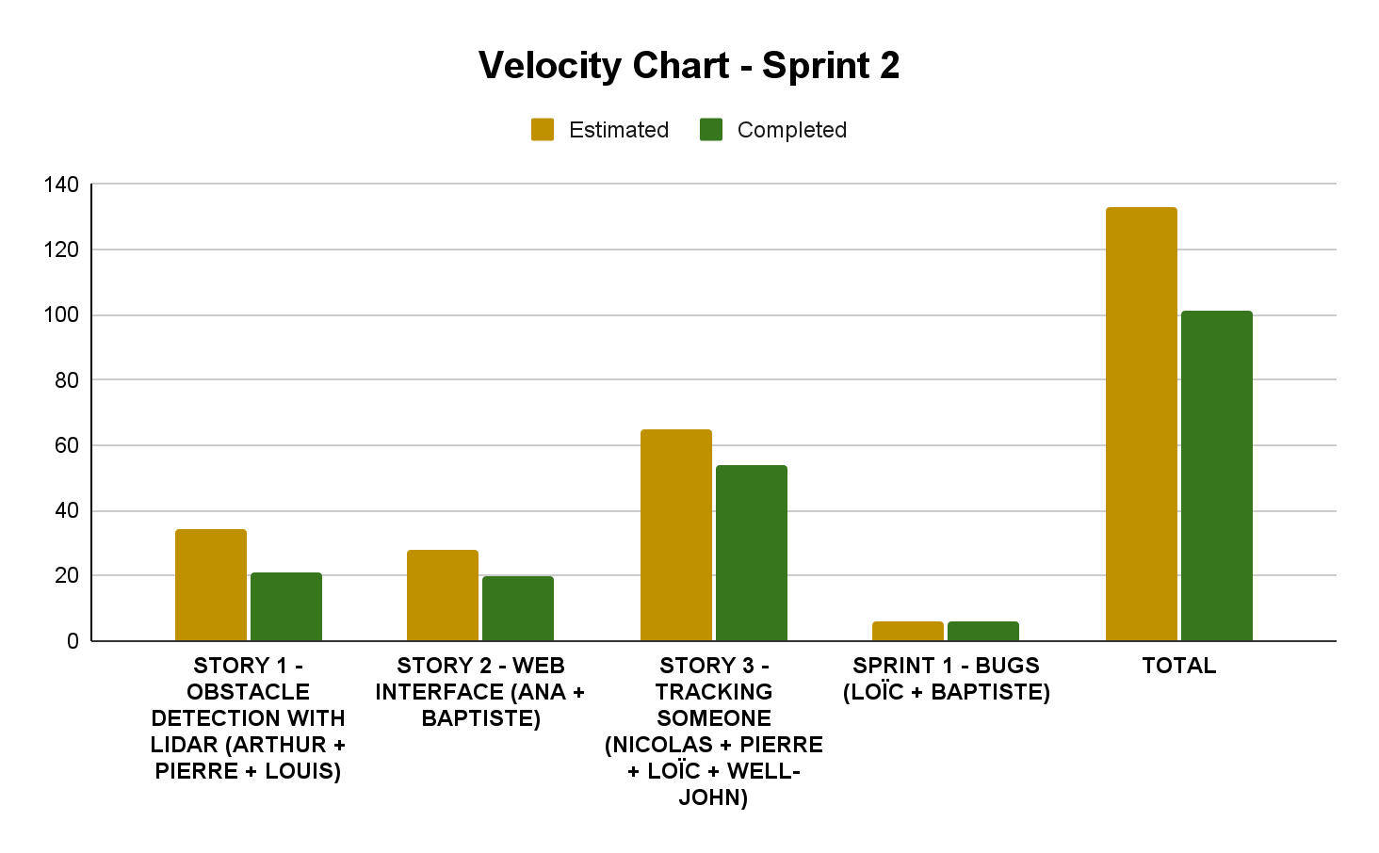

Slide 17
Release Vision
- First version of the app.
- Detect obstacles with LIDAR
- Recognize a human.
- Follow a tracked person.
- First version of the state machine.
- Project plan done.
Sprint 0
Sprint 2
Sprint 1
Sprint 3
- Improve Tracking mode
- Improve Web Interface
- A safer and a more accurate Tracking mode
- Final state machine.
- Manual control.
- Obstacle detection.
- Emergency stop button on the remote control.
- HMI : visual feedback on the computer (console).

Slide 18
Release Vision
- First version of the app.
- Detect obstacles with LIDAR
- Recognize a human.
- Follow a tracked person.
- First version of the state machine.
- Project plan done.
Sprint 0
Sprint 2
Sprint 1
Sprint 3
- Improve Tracking mode
- Improve Web Interface
- A safer and a more accurate Tracking mode
- Final state machine.
- Manual control.
- Obstacle detection.
- Emergency stop button on the remote control.
- HMI : visual feedback on the computer (console).

Slide 19
Sprint 3 goals story 1
Improve Tracking mode : As a user, I want to be followed in a small curve and i want the X-car stopped if an obstacle appear between us : Nicolas - Arthur - Louis
Tasks
Task 1- Detect a particular human
13 Story Points
Task 2- Follow a human in a small curve
20 Story Points
Task 3- Avoid an obstacle between the user and the X-car
20 Story Points

Slide 20
Sprint 3 goals story 1
Improve Tracking mode : As a user, I want to be followed in a small curve and i want the X-car stopped if an obstacle appear between us : Nicolas - Arthur - Louis
Test
Check if the Xcar can recognise only the user in a window vision with several humans
Check if in a 15 degree turn the X-car can follow the user
Check if X-Car avoid an obstacle that appears behind the user in a straight line

Slide 21
Sprint 3 goals story 2
Improve Web Interface : As a user, I want a more interactive interface accessible on my smartphone : Baptiste - Well-John
Tasks
Task 1- Have access to the interface on smartphone
8 Story Points
Task 2- Display history and battery feedback on the interface
8 Story Points
Task 3- Add interactive state machine to the interface
13 Story Points
Task 4- Improve the joystick on the interface
5 Story Points

Slide 22
Sprint 3 goals story 2
Improve Web Interface : As a user, I want a more interactive interface accessible on my smartphone : Baptiste - Well-John
Test
Check if we can have access to the interface on the smartphone
Check if the history, the battery level and the state machine are display in real time
Check if the X-Car control react to the command from the joystick

Slide 23

Sprint 3 goals story 3
A safer and a more accurate tracking mode : As a user, I want the X-car to be safer and more accurate : Pierre - Loïc - Ana
Tasks
Task 1- More accuracy tracking combining the Lidar and the Camera
13 Story Points
Task 2- Combine the lidar/camera with the car control
5 Story Points
Task 3- Update the state machine code with tracking mode and sensor checking
5 Story Points

Slide 24
Sprint 3 goals story 3
A safer and a more accurate tracking mode : As a user, I want the X-car to be safer and more accurate : Pierre - Loïc - Ana
Test
Check if the angle and the distance between the car and the user is better
Check if the value return by the lidar is received by our car_control
Check if the tracking mode is operational

Slide 25
Annex 1 : Obstacle detection with Lidar
Demo video 1 : https://drive.google.com/file/d/1MKXGXYR1N1UGXpxMEty7d87J06h8O5PM/view?usp=share_link
Demo video 2 : https://drive.google.com/file/d/1SU1Qd5ggXF-aJnxv0PYLp2LjRuocEo0Z/view?usp=share_link
Demo video 3 : https://drive.google.com/file/d/1rnTyEod8MMaEZUc8faUPkqfDSsfgRDvL/view?usp=share_link

Slide 26
Annex 2 : Web interface
Demo video 1 : https://drive.google.com/file/d/1V3iBpFQsGqw70xX5_shy5tVATlHuQR7p/view?usp=share_link
Demo video 2 : https://drive.google.com/file/d/1Tj4BdfDJEzBMkI4pki3EfTR2Fn32BSBQ/view?usp=share_link

Slide 27
Annex 3 : Tracking a person
Demo video1 : https://drive.google.com/file/d/1VWtnhrUUv4bWb3g2I1dd3qVjA-9eP9Hr/view?usp=share_link
Demo video1 : https://drive.google.com/file/d/1lS8fp1Xm7_tYnlALUevbTTMCEUVjlBCb/view?usp=drive_link

Slide 28
Annex 4 : State machine variables
Variables
obstacle_ar, obstacle_av : if there is an obstacle at 20 cm forward/backward
obstacle_unavoidable: inevitable obistacle
sensor_dead : a/multiple sensors are not working anymore
connection: connection with user established
emergency_btn : emergency button is pressed
dir_av, dir_ar : movement direction of the car (forward or backward)
ps : previous state, at each transition the last state is kept in memory
stop_timer: time of state passage
manual, tracking, autonomous, Idle : button on the HMI
return : return button on the HMI

Slide 29
Annex 5 : State machine transitions
Transitions
1) Manual Mode -> Security Mode [((obstacle_av and dir_av) or (obstacle_ar and dir_ar)) or or sensor_dead ] and connection and !emergency_btn and !emergency_shutdown
2) Manual Mode -> Idle return and !manual and connection and !sensor_dead and !emergency_btn and !emergency_shutdown
3) Manual Mode -> Emergency stop emergency_btn and !emergency_shutdown
4) Manual Mode -> Manual Mode !emergency_btn and ((obsatcle_ar and dir_av) or (obstacle_av and dir_ar) or (!obstacle_ar and !obstacle_av)) and manual and !return and connection and !sensors_dead and !emergency_shutdown
5) Manual Mode -> Emergency_Shutdown emergency_shutdown
6) Manual Mode -> Standby !emergency_btn and !emergency_shutdown and !connection
7) Tracking Mode -> Security Mode [(((obstacle_av and dir_av) or (obstacle_ar and dir_ar)) and obstacle_unavoidable) or sensor_dead ] and connection and !emerrgency_btn and !emergency_shutdown
8) Tracking Mode -> idle Idle and !tracking and connection and !sensor_dead and !emergency_btn and !emergency_shutdown
9) Tracking Mode -> Emergency Stop emergency_btn and !emergency_shutdown

Slide 30
Annex 6 : State machine transitions
10) Tracking Mode -> Tracking Mode ( ( ((obstacle_av and dir_av) or (obstacle_ar and dir_ar)) and !obstacle_unavoidable) or (!obstacle_ar and !obstacle_av) ) and connection and !sensors_dead and !emergency_btn and tracking and !return and !emergency_shutdown
11) Tracking Mode -> Emergency_Shutdown emergency_shutdown
12) Tracking Mode -> Standby !emergency_btn and !emergency_shutdown and !connection
13) Autonomous Mode -> Security Mode [(((obstacle_av and dir_av) or (obstacle_ar and dir_ar)) and obstacle_unavoidable) or sensor_dead ] and connection and !emerrgency_btn
14) Autonomous Mode -> idle Idle and !autonomous and connection and !sensor_dead and !emergency_btn
15) Autonomous Mode -> Emergency Stop emergency_btn
16) Autonomous Mode -> Autonomous Mode ( ( ( (obstacle_av and dir_av) or (obstacle_ar and dir_ar) ) and !obstacle_unavoidable) or (!obstacle_ar and !obstacle_av)) and connection and !sensors_dead and !emergency and autonomous and !return and !emergency_shutdown
17) Autonomous Mode -> Emergency_Shutdown emergency_shutdown
18) Security Mode -> Manual Mode ( (!obstacle_ar and !obstacle_av) or ((obstacle_ar and dir_av) or (obstacle_av and dir_ar))) and !sensor_dead and connection and ps = manual and !emergency_btn and !emergency_shutdown

Slide 31
Annex 7 : State machine transitions
19) Security Mode -> Tracking Mode ((!obstacle_ar and !obstacle_av) or (obstacle_av and dir_ar) or (obstacle_ar and dir_av) or (((obstacle_av and dir_av) or (obstacle_ar and dir_ar))and !obstacle_unavoidable)) and !sensor_dead and connection and ps = tracking and !emergency_btn and !emergency_shutdown
20) Security Mode -> Autonomous Mode ((!obstacle_ar and !obstacle_av) or (obstacle_ar and dir_av) or (obstacle_av and dir_ar) or (((obstacle_av and dir_av) or (obstacle_ar and dir_ar)) and !obstacle_unavoidable)) and !sensor_dead and connection and ps = autonomous and !emergency_btn and !emergency_shutdown
21) Security Mode -> Security Mode (obstacle_unavoidable or sensor_dead or !connection) and !emergency_btn and !emergency_shutdown
22) Security Mode -> Emergency Stop emergency_btn and !emergency_shutdown
23) Security Mode -> Emergency_Shutdown emergency_shutdown
24) Emergency Stop -> Idle btn_to_Idle and !emergency_shutdown and connection and !sensors_dead and !emergency_stop and !emergency_shutdown
25) Emergency Stop -> emergency Stop (!btn_to_idle or !emergency_shutdown or emergency_btn) and !emergency_shutdown
26) Emergency Stop -> Security Mode sensors_dead and !emergency_shutdown and !emergency_btn
27) Emergency Stop -> Emergency_Shutdown emergency_shutdown
28) Emergency Stop -> Standby !connection and !emergency_shutdown

Slide 32
Annex 8 : State machine transitions
29) Standby -> idle connection and !emergency_btn and !emergency_shutdown
30) Standby->standby !connection and !emergency_btn and !emergency_shutdown
31) Standby ->Emergency_Shutdown emergency_shutdown
32) idle -> Security Mode sensor_dead and !emergency_btn and !emergency_shutdown and connection
33) idle->Emergency_Stop emergency_btn and !emergency_shutdown and connection
34) idle -> Manual Mode manual and !tracking and !autonomous and connection or !sensor_dead and !emergency_btn and !emergency_shutdown
35) idle -> Tracking Mode tracking !manual and !autonomous and connection or !sensor_dead and !emergency_btn and !emergency_shutdown
36) idle -> Autonomous Mode autonomous and !tracking and !manual and connection and !sensor_dead and !emergency_btn and !emergency_shutdown
37) idle->idle !sensors_dead and connection and !emergency_btn and !emergency_shutdown
38) Idle -> Emergency_Shutdown emergency_shutdown

Slide 33
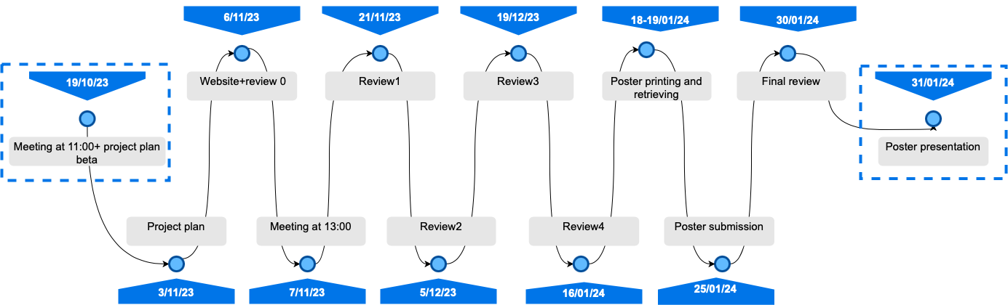
Annex 9 : Deliverables

